Slide 1
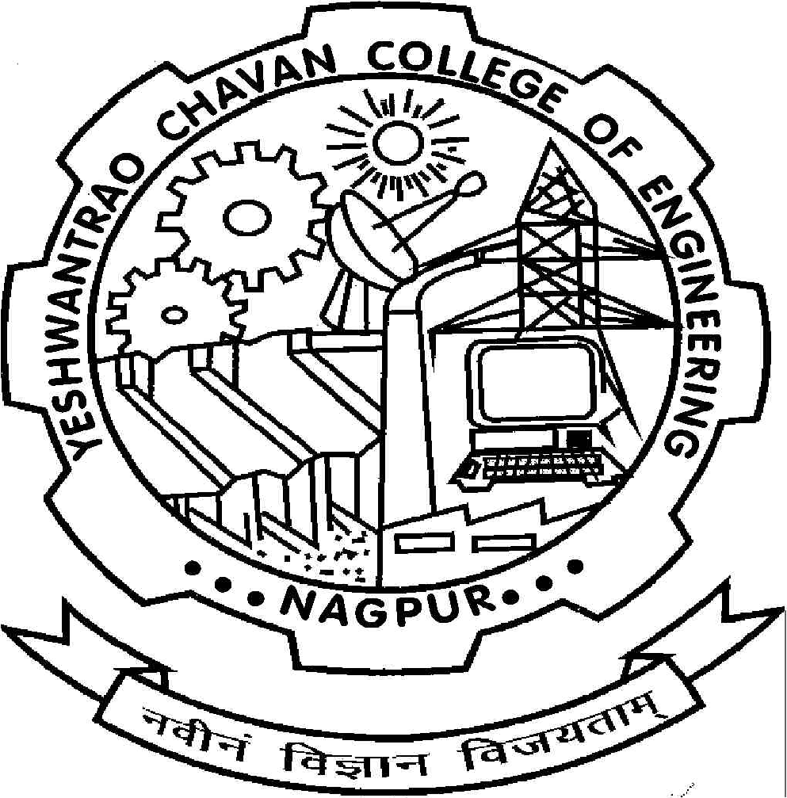
Yeshwantrao Chavan college of Engineering, Nagpur
Department of Computer Science & Engineering
Academic Session 2025-26
INTDE26MRGN001
By
Sushant Ambekar, Roll No: 155
Undertaken at
Cognizant Technology Solutions Corporation
Guide
Prof. Pratibha Waghale

Slide 2
Table of Contents
Problem Statement
Objectives & Scope
Methodology
Tools/Technologies Used
Implementation & Outcome
Problems faced and how they were resolved
Outcome of Internship
References

Slide 3
1. Problem Statement
Modern web applications require scalable, reliable, and fast deployment pipelines along with efficient frontend and backend integration. Manual deployment methods are error‑prone and time‑consuming.
During the internship, the problem addressed was to develop a full‑stack MERN application and automate its deployment using DevOps practices to ensure smooth integration, testing, and delivery.

Slide 4
2. Objectives & Scope
To learn core web technologies to build responsive and user‑friendly interfaces using HTML, CSS, and JavaScript.
To develop single‑page applications using React with components, forms, routing, and state management.
To build backend services using Node.js and Express, and perform CRUD operations using MongoDB.
To automate deployment using Git, Docker, and CI/CD pipelines to deploy MERN applications efficiently.

Slide 5
3. Methodology
Followed Agile software development methodology.
Requirement analysis and task breakdown.
Full‑stack application development in iterations.
API integration between frontend and backend
CI/CD pipeline creation for automated deployment
Testing and monitoring of deployed applications

Slide 6
4. Tools/Technologies Used
Development
  React.js
  Node.js
  Express.js
  MongoDB
DevOps & Deployment
  Git & GitHub
  Jenkins / GitHub Actions (CI/CD)
  Docker (containerization)
  Cloud platforms (AWS / Azure)
Other Tools
  Visual Studio Code
  Postman
  npm

Slide 7
5. Implementation & Outcome
Implementation
- Currently undergoing training to design and develop responsive web user interfaces using HTML5, CSS3, and JavaScript, and building single‑page applications using Angular and React.
- Backend development using Node.js and Express is being implemented with MongoDB for CRUD operations.
- DevOps practices such as Git‑based version control, Docker containerization, and CI/CD pipeline setup using Jenkins are also being learned and applied for application deployment.
Outcome
Upon completion, the training will enable the development of complete MERN stack web applications with efficient frontend–backend integration, automated deployment pipelines, early error detection, and scalable deployment following industry‑standard DevOps practices.

Slide 8
7. Outcome of Internship
Strong understanding of MERN stack development
Gained practical knowledge of DevOps and CI/CD pipelines
Learned containerization and cloud deployment
Improved teamwork, debugging, and professional communication skills
Exposure to real‑world enterprise application workflows

Slide 9
8.References
https://react.dev
https://nodejs.org
https://expressjs.com
https://www.mongodb.com
https://www.docker.com
https://www.udemy.com

Slide 10


